Slide 1
Web Accessibility (A11y)
Josh Harrison, Intuit
Staff Software Engineer
Time Tracking/Payroll Accessibility Leader

Slide 2

Josh Harrison
Staff Software Engineer, Intuit
Web Developer
Accessibility Champion
https://www.linkedin.com/in/jjharrison/

Slide 3
Why is Accessibility important?
What is Web Accessibility?
Inclusive Design & Diverse Abilities
Principles
Assistive technologies
What you can do

Slide 4
Why is Accessibility important?

Slide 5


Slide 6
1 in 12 men have trouble differentiating colors (color blindness) - colourblindawareness.org
1 out of 7 people in the world has some sort of disability - World Health Organization
20% of the US Population has some sort of disability - US Census Bureau
98% of web home pages have accessibility issues - WebAIM Million Report

Slide 7
What is Accessibility?
Accessibility is the design of products, devices, services, or environments for people with disabilities.

Slide 8
Why is Accessibility important?
Accessibility is the design of products, devices, services, or environments for people with disabilities.
Accessibility means independence.

Slide 9
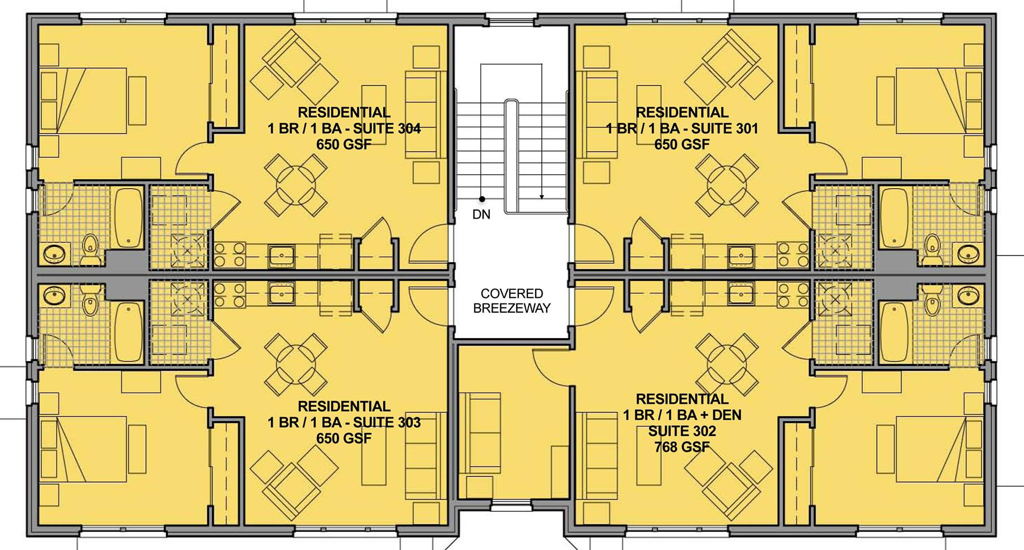
Importance of Inclusive Design

Slide 10
Importance of Inclusive Design

Slide 11
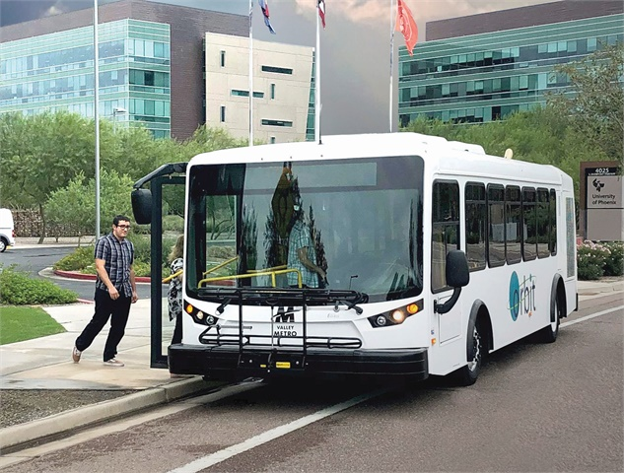

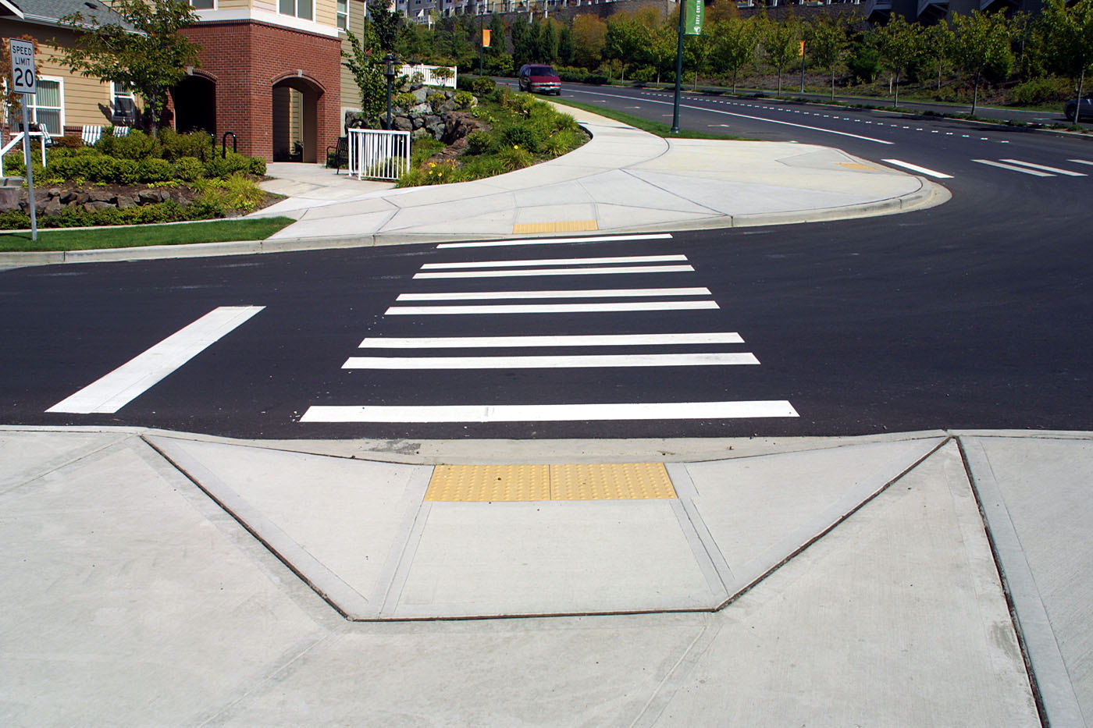


Accessibility benefits everyone!

Slide 12
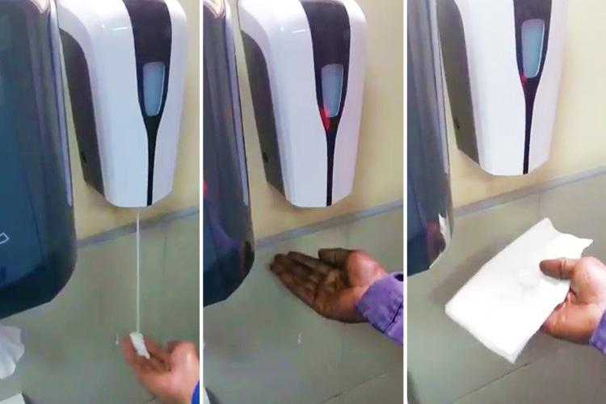
Failing to design inclusively

Slide 13
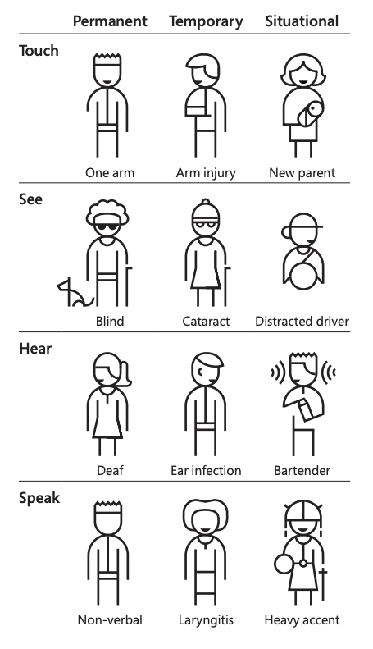
Diverse abilities
“Solve for one, extend to many”
Microsoft Inclusive Design Kit

Slide 14
Web Accessibility principles
WWW is fundamentally designed to work for all people
WWW removes barriers to communication and interaction
Badly designed websites, applications, technologies, etc. introduce barriers

Slide 15
Web Accessibility principles
WWW is fundamentally designed to work for all people
WWW removes barriers to communication and interaction
Badly designed websites, applications, technologies, etc. introduce barriers
Many organisations are waking up to the fact that embracing accessibility leads to multiple benefits – strengthening brand presence, improving customer experience, colleague productivity, and reducing legal risks.
Paul Smyth, Head of Digital Accessibility, Barclays

Slide 16
Web Accessibility principles
WWW is fundamentally designed to work for all people
WWW removes barriers to communication and interaction
Badly designed websites, applications, technologies, etc. introduce barriers
Many organisations are waking up to the fact that embracing accessibility leads to multiple benefits – strengthening brand presence, improving customer experience, colleague productivity, and reducing legal risks.
Paul Smyth, Head of Digital Accessibility, Barclays

Slide 17
Web Accessibility principles
WWW is fundamentally designed to work for all people
WWW removes barriers to communication and interaction
Badly designed websites, applications, technologies, etc. introduce barriers
Many organisations are waking up to the fact that embracing accessibility leads to multiple benefits – strengthening brand presence, improving customer experience, colleague productivity, and reducing legal risks.
Paul Smyth, Head of Digital Accessibility, Barclays

Slide 18
Web Accessibility principles
WWW is fundamentally designed to work for all people
WWW removes barriers to communication and interaction
Badly designed websites, applications, technologies, etc. introduce barriers
Many organisations are waking up to the fact that embracing accessibility leads to multiple benefits – strengthening brand presence, improving customer experience, colleague productivity, and reducing legal risks.
Paul Smyth, Head of Digital Accessibility, Barclays

Slide 19
Web Accessibility principles
WWW is fundamentally designed to work for all people
WWW removes barriers to communication and interaction
Badly designed websites, applications, technologies, etc. introduce barriers
Many organisations are waking up to the fact that embracing accessibility leads to multiple benefits – strengthening brand presence, improving customer experience, colleague productivity, and reducing legal risks.
Paul Smyth, Head of Digital Accessibility, Barclays

Slide 20
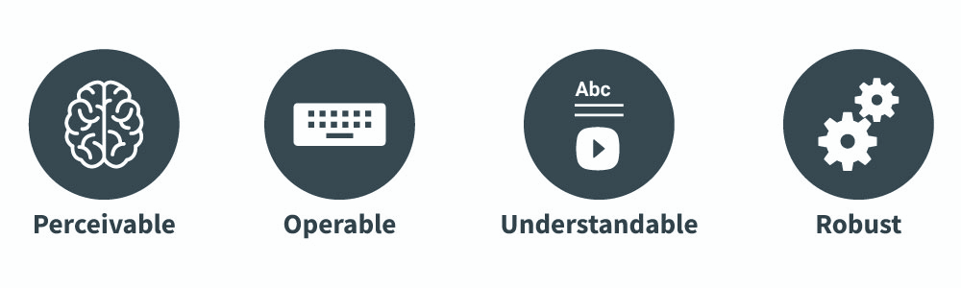
Web Accessibility principles - POUR

Slide 21
POUR
Perceivable:
People can see, hear, and/or feel the content

Slide 22
POUR
Operable:
People can use the software via keyboard, mouse, voice, etc.

Slide 23
POUR
Understandable:
People get clear and simple language

Slide 24
POUR
Robust:
People can use different assistive technologies

Slide 25
Assistive Technologies

Slide 26
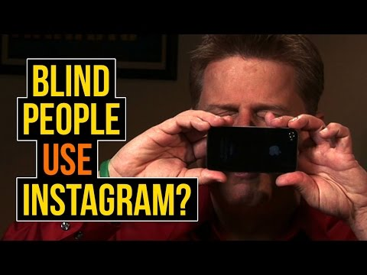
Assistive Technologies
Screen reader

Slide 27

Assistive Technologies
Screen reader
Text-to-speech

Slide 28
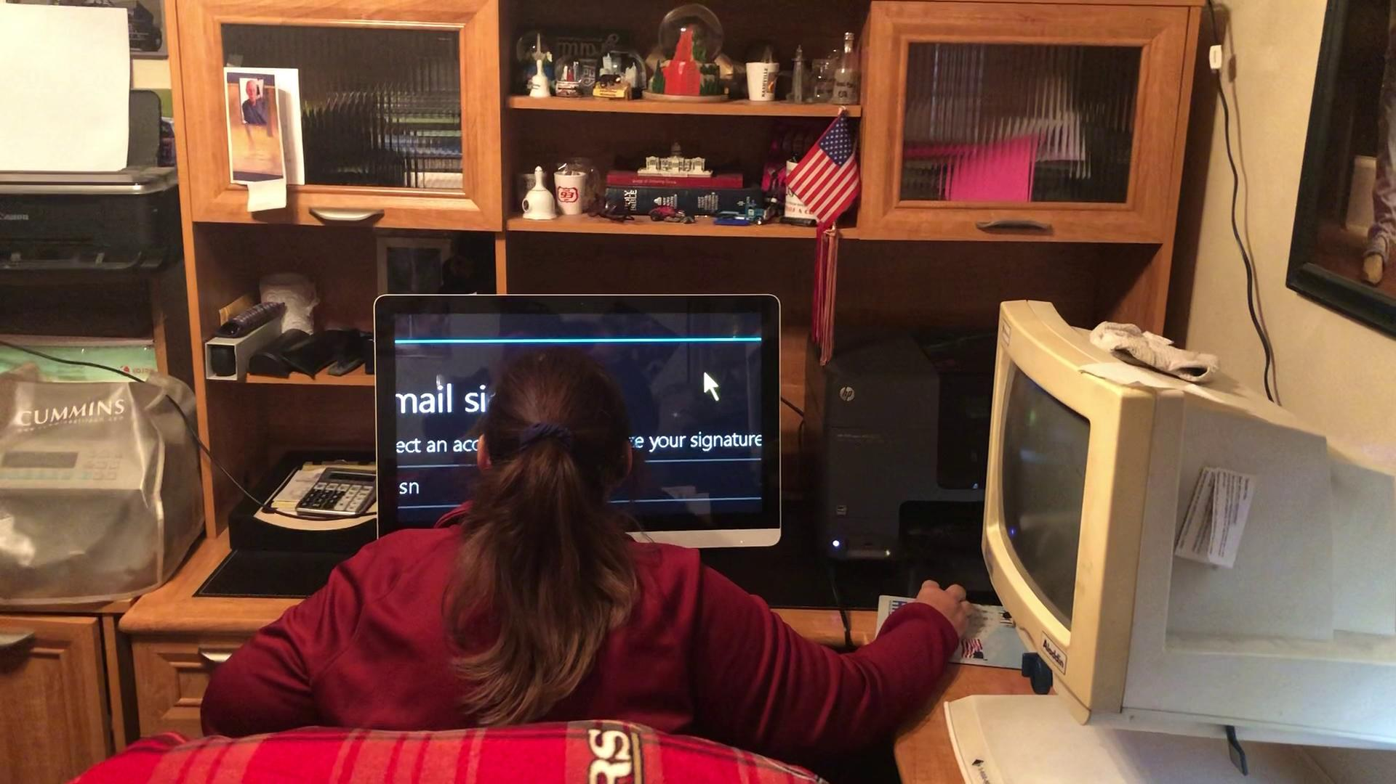
Assistive Technologies
Screen reader
Text-to-speech
Screen magnification

Slide 29
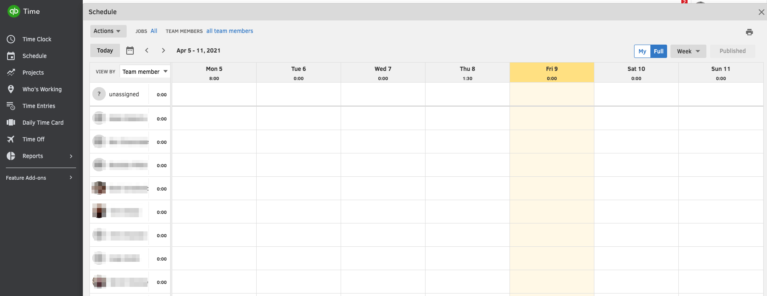
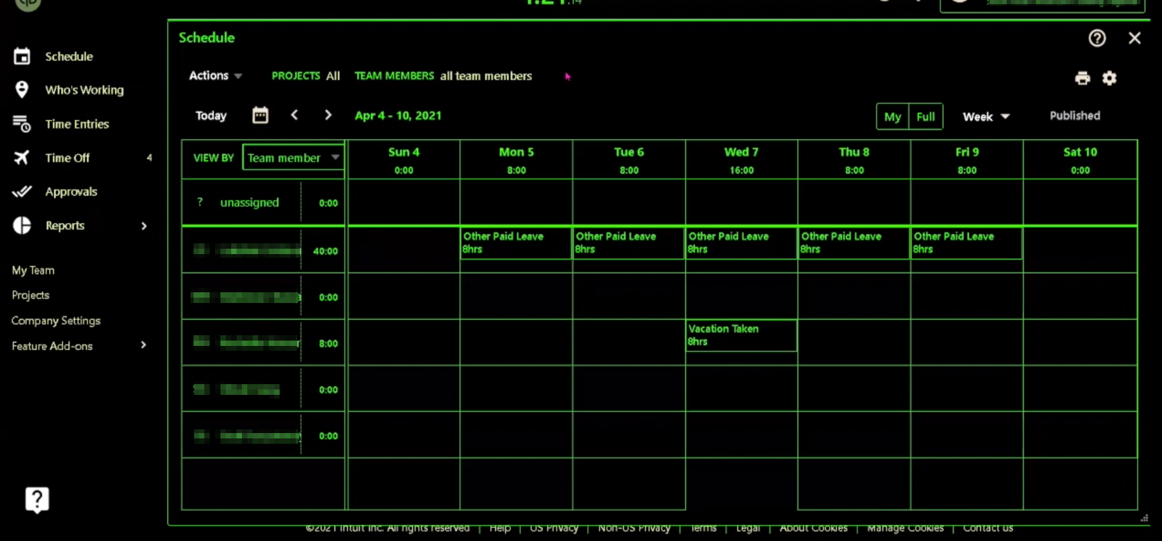
Assistive Technologies
Screen reader
Text-to-speech
Screen magnification
Custom color theming

Slide 30
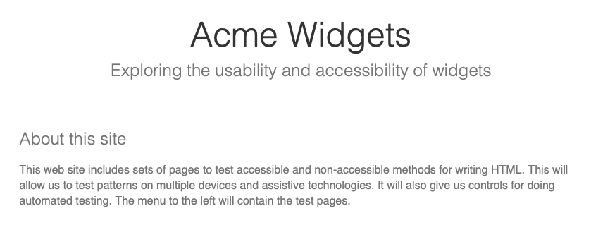
Using a screen reader
Accessibility Testing Site

Slide 31
What you can do
Use semantic HTML

Slide 32
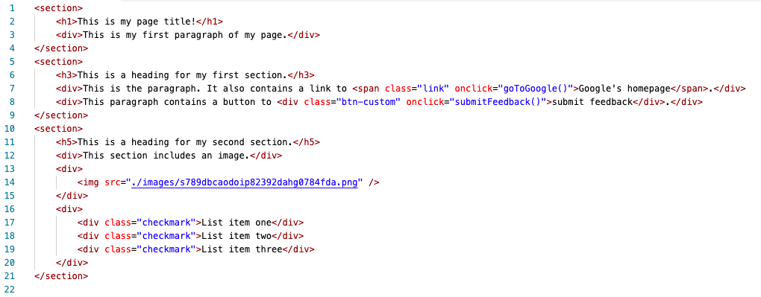
What you can do
Use semantic HTML

Slide 33

What you can do
Use semantic HTML

Slide 34
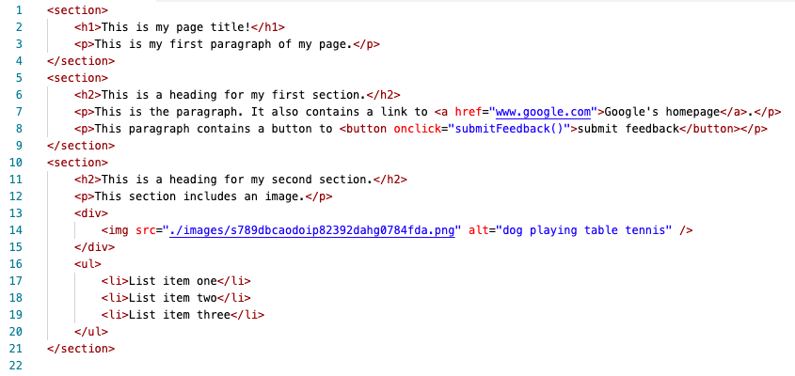
What you can do
Use semantic HTML

Slide 35


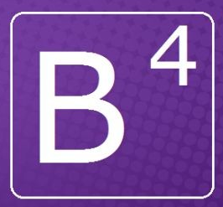

What you can do
Use semantic HTML
Use reusable UI components that are accessible
Vue.js Accessibility Basics

Slide 36
What you can do
Use semantic HTML
Use reusable UI components that are accessible
Test the UI using only your keyboard
tab / shift+tab to move forwards and backwards
enter to activate a button or a link
space to check/uncheck a checkbox
up/down/left/right to select a radio button in a radio button group

Slide 37
What you can do
Use semantic HTML
Use reusable UI components that are accessible
Test the UI using only your keyboard
Test the UI using a screen reader
Windows - download and use NVDA
Mac/iOS - use VoiceOver (built-in)
Android - use Talkback (built-in)

Slide 38
Links to resources
Web Content Accessibility Guidelines (WCAG)
NVDA Shortcut Keys
MacOS VoiceOver Guide
Android TalkBack Guide
Vue.js Accessibility Basics
Accessibility Testing Site
https://github.com/joshharrison626/Intro-To-Accessibility

